Slide 1




Programowanie obiektowe
To do list
Tatsiana Trus 4 grupa
bioinformatyka

Slide 2


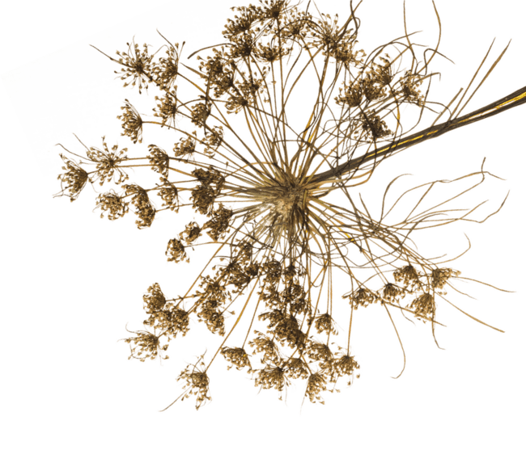


Key Mobile App
Statistics 2022
Others 7.4%
Map 1.6%
Social App 22.3%
Health & Wellness 2.2%
Music 3.1%
Productivity 3.2%
Mobile Browser 7.4%
Gaming 19.5%
Entertainment 11.2%
Communication 16.5%
In 2022, the time spent as per the record was

Slide 3







what the user sees
to-do list for the day
the full date of the day is indicated (year, month, day)
if the user needs it, he can create a clarification (for example: you need to go to the store and you can write a list of products that you need to buy)
notifications on cases go in turn. and at the end of the tasks for today, the user will see the tasks for tomorrow

Slide 4






4
1
https://www.emizent ech.com/blog/key- mobile-app- statistics.html
sources
https://zenuacadem ie.com/statistiques/s tatistiques- mondiales-mobile/
2
https://www.wordt emplatesonline.ne t/to-do-list- checklist- templates/
3
https://www.uplabs.co m/posts/todo-listing- pixel-2

Slide 5
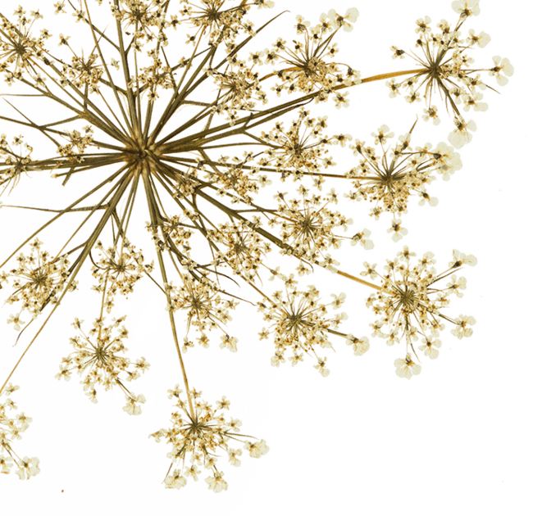





Thank You
for listening!

